Slide 1


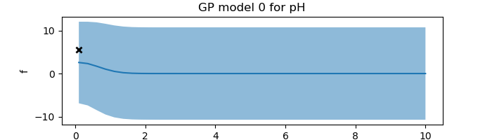
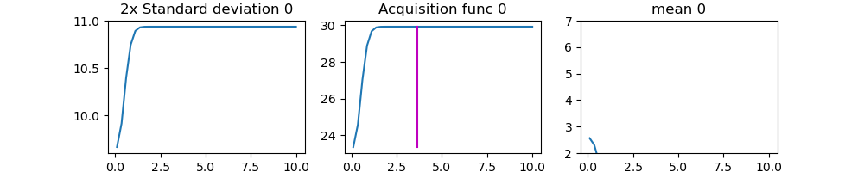
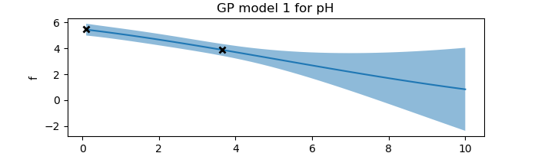
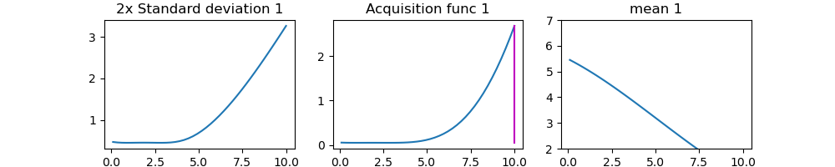

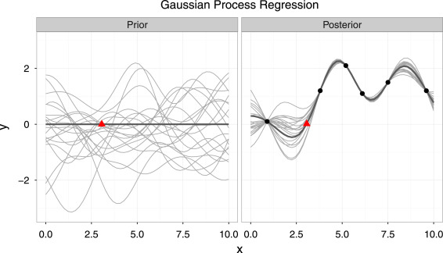
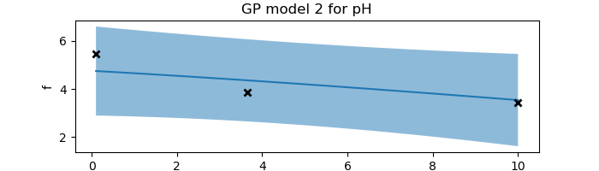
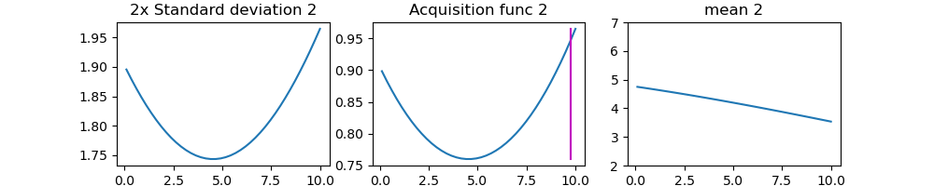
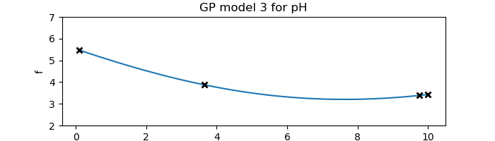
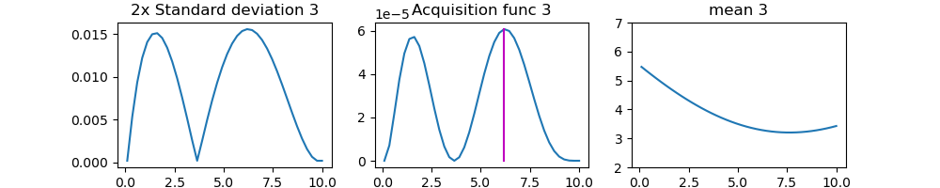
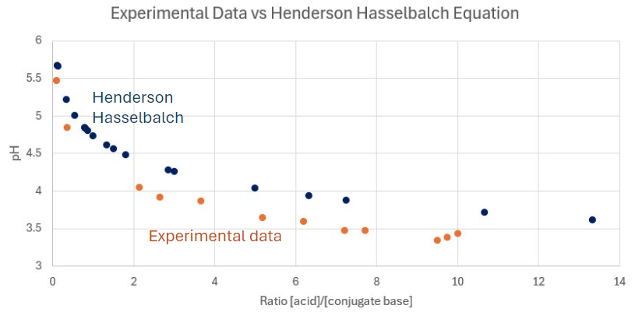
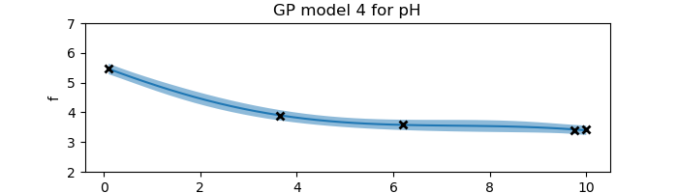
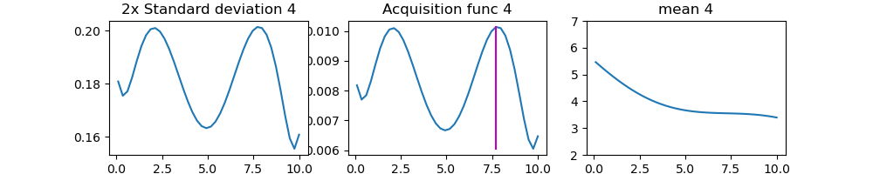
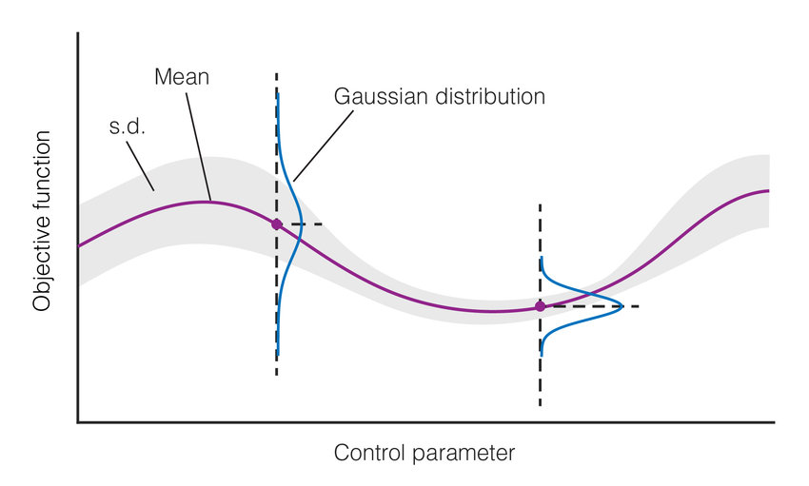
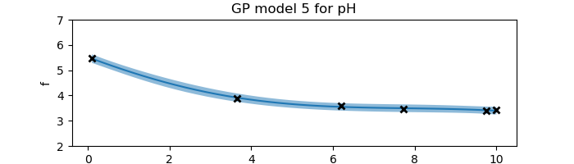
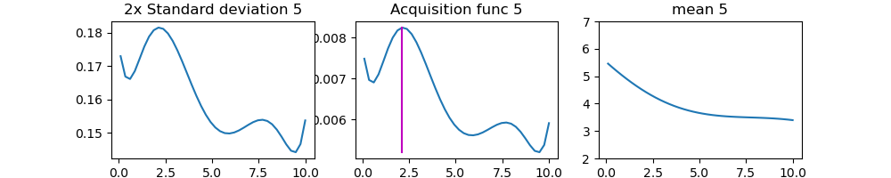
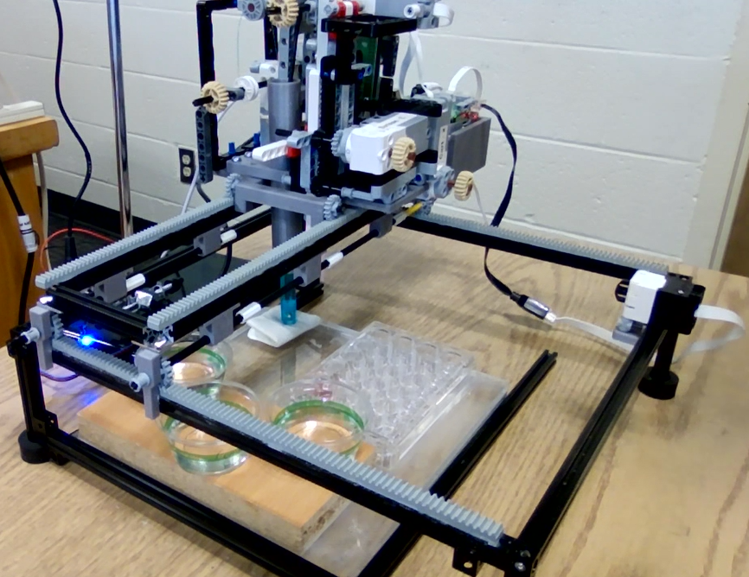
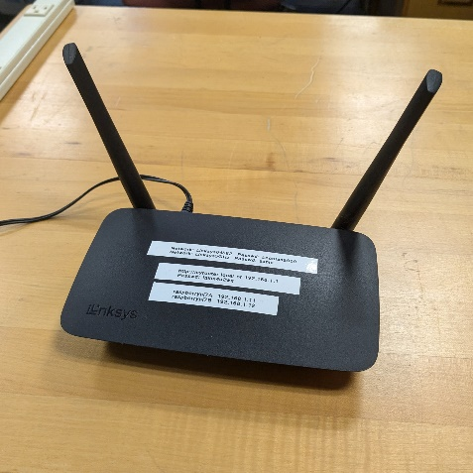
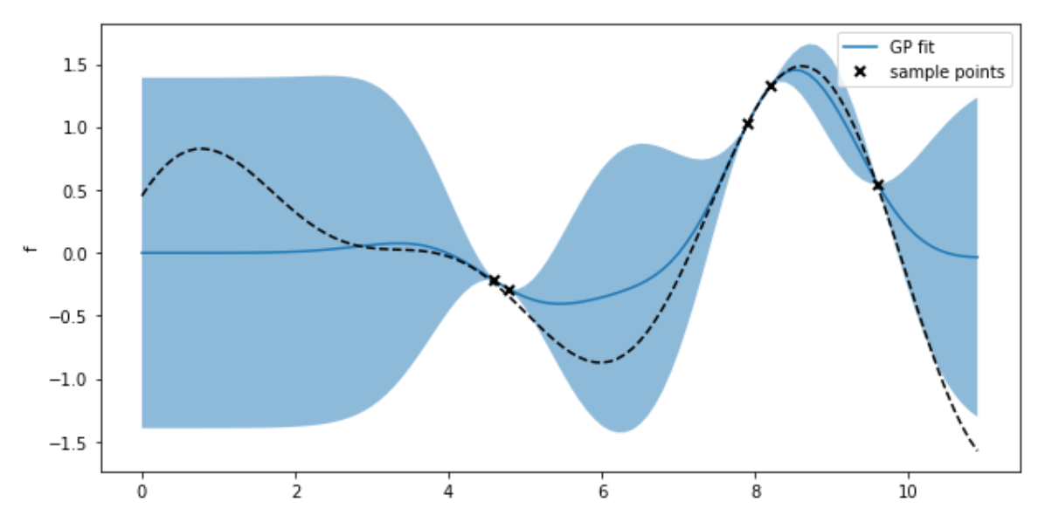
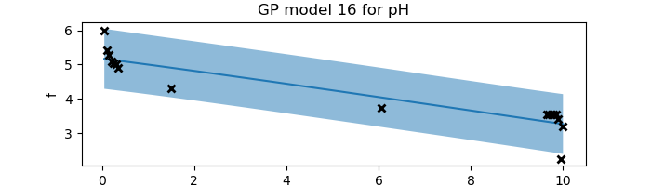
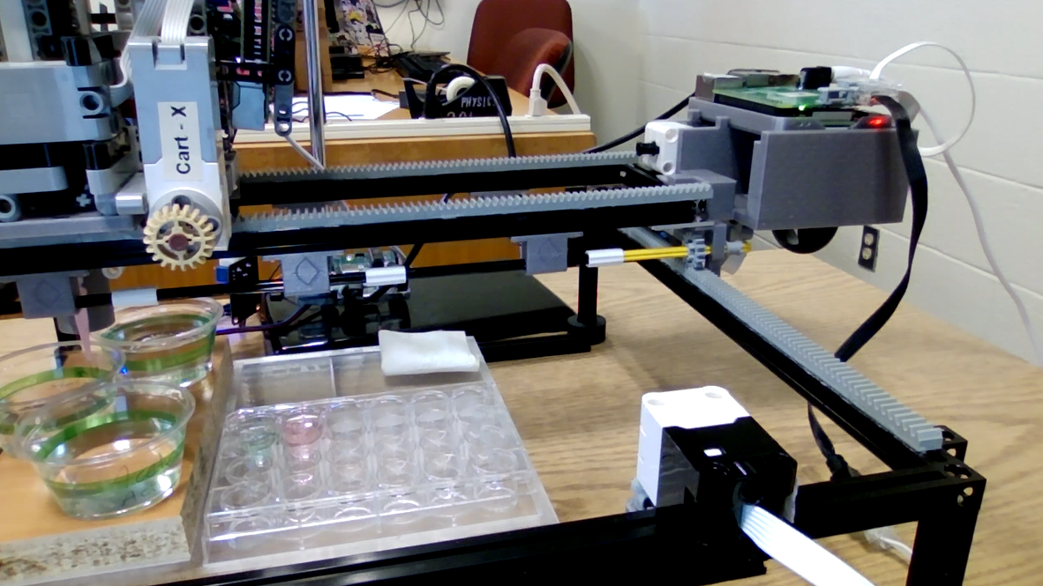
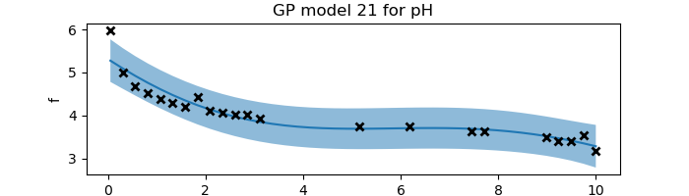
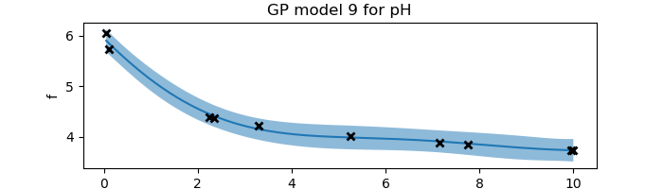
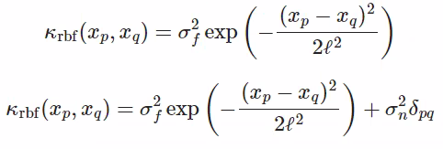
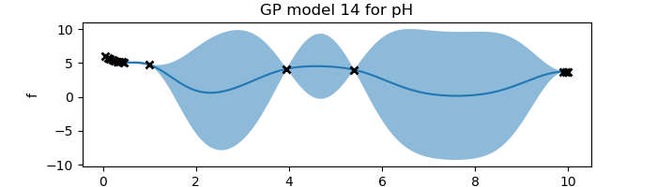
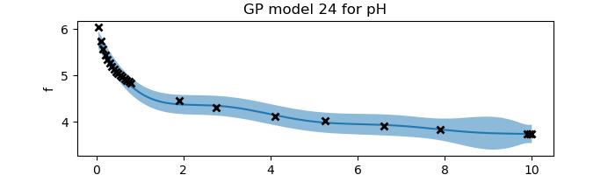
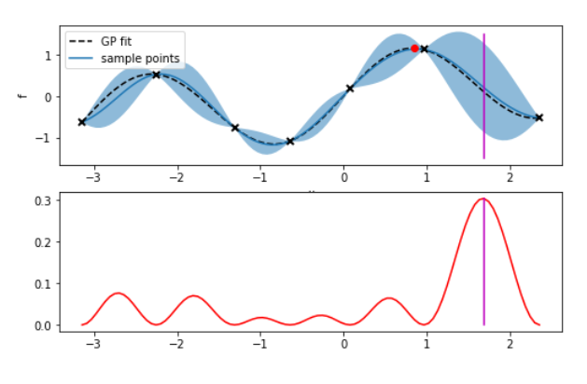
Automation and Machine Learning: How a Robot Can Conduct Its Own Experiments Using Gaussian Processes
Miller Gruen and Adi Timin - Hauber Research Fellowship 2024
Advisor: Dr Mary Lowe, Physics Department, Loyola University Maryland
Introduction
Experimental Results: “Exploration”
When researching, scientists often need to take large amounts of data and conduct numerous tests. Rather than taking many measurements that require time, resources, and money, it may be better to automate the task. Beyond automation, imagine if a device were able to do more than simply repeat a task, if it could make its own decisions and conduct an experiment wholly without needing constant human supervision. This could combat the complexity of research and optimize the taking of data, as well as greatly easing the burden on scientists in fields that require large amounts of testing, such as chemistry, physics, drug discovery, biology, material synthesis, and more. We can accomplish this using Gaussian processes applied to machine learning. LEGOLAS, which stands for LEGO-based low-cost autonomous scientist, is a robotic device capable of applying these principals when measuring the pH of two liquids when mixed, such as an acid and a conjugate base. Our experiment could be viewed as a proof of concept of a principal that is extremely valuable and can be applied to many other disciplines, settings, and applications. The goal of this project was to understand machine learning and its applications, and to achieve this, we investigated both exploration and exploitation based machine learning, as well as combining the two. We explored machine learning both experimentally and computationally.
Our goal was to discover the shape of the curve of the pH that results when mixing together an acid and a conjugate base.
We used 0.1M Acetic Acid and 0.1M Sodium Acetate.
The curve begins as a line at 0, the mean of all infinite possibilities for the curve to take.
We began by taking a measurement at 0.1 ratio of the [acid]/[conjugate base].
With it, we obtained a curve with the uncertainty required to create an acquisition function.
From this, we obtained the next data point.
This continued until the curve was found.
We chose to test the relationship between pH and a ratio of acid and conjugate base because the relationship is governed by a known equation: the Henderson Hasselbalch equation.
Theory and Background
Apparatus
Gaussian processes is a method of doing regression. It tells us which functions are most likely to describe the data we are observing at any time during an experiment. When we have no data, our prior model has endless possibilities. Then as we observe more and more data, we get a better idea of the true underlying function. This regression method is non-parametric, which means we don’t have an equation that describes the function we are fitting, just a curve - a set of points.
LEGOLAS, which stands for LEGO-based low-cost autonomous scientist, is a robotic kit created by a team of students and faculty at the University of Maryland, as well as a team from the National Institute of Standards and Technology. It is the solution to the issue that often devices for material synthesis, especially for machine learning, are extremely expensive, and so LEGOLAS was created to be a low-cost solution to allow any institution to be able to teach machine learning in any setting.
Legolas possesses:
2 Raspberry Pis and build hats to control motors
5 Lego Motors
1 Arduino and 1 pH sensor
1 pipette with a plunger
The Raspberry Pis connect wirelessly to a computer running the code and run the Lego motors using a build hat to connect.
We selected to use a known relationship in order to understand the concepts behind the machine learning and to ensure our results were applying them correctly.
Our data aligns with the shape of the known curve, showing that our function successfully gained the information about the curve created by this relationship.
Figure 1
In essence, a Gaussian process is a collection of normally distributed random variables. Thus, for each value of the control parameter, we have a Gaussian probability distribution (also known as a Bell curve) as an output. The variance in the distributions tells us about the uncertainty in the function. Where we have a better idea of the underlying function, the distributions are narrower. This plotted variance includes both the uncertainty in the model due to the lack of data we have (epistemic uncertainty), and the noise and fluctuations in the data itself (aleatoric uncertainty). The uncertainty is plotted on Figure 3 as the light-blue region (2 standard deviations). The darker-blue line on this graph is the mean of the function, what we call the surrogate function. It is the curve that most likely represents the true curve. The underlying curve that we desire to find the shape of is plotted with the black dotted line.
The way to find out the shape of our surrogate function is by using a ”kernel” (covariance function). For any two given inputs, it tells us
In the future, we hope to be able to test other acquisition functions and kernels, as well as explore other applications of machine learning.
Computational & Experimental Results: New acquisition function
Figure 2
We decided that this topic can be researched in more depth by not constraining ourselves to the apparatus that makes running even a single trial a lengthy process, limiting the number of trials we can do in a given period and making it difficult to get instant feedback on any changes made to the code. We started generating data artificially to side-step the physical data collection process. It was generated based on the Henderson-Hasselbach equation, and eventually we were able to also add noise to the generated data to try to imitate
Lego motor
Water
(rinsing)
Raspberry Pi and Build Hat
the behavior of the device. This computational work was also a way for us to explore Gaussian processes and experiment with different aspects of it, such as adjusting the hyperparameters, changing the kernel, adjusting the acquisition function, or changing the number of data points that can be taken during a trial.
Figure 3
Base
Acid
Limit switch
Figure 4
Standards
Experimental wells
how similar the outputs are, and thus informs us of the shape the surrogate function is likely to take (if the outputs are more similar, the function will be smoother, an vice versa). The kernel is also used to construct a covariance matrix, which we use to calculate the mean and the variance of the function
The code is written in python and run completely on a separate computer where the machine learning and Gaussian processes calculations are completed. Other parts of the code could be run using a Jupyter Notebook.
The code is able to:
Establish communication between computer and pis
Functions for:
moving the motors in the x and y directions
Pipetting liquid
Moving pH sensor vertically
pH measurement
Cleaning and drying the pH sensor
Apply the machine learning and regression
at each point (which is how we get such a visualization as on Figure 3).
This information is then used to determine what the best data point to take next is. For that we use an “acquisition function”, which quantifies the desirability of taking a measurement at each point. If the acquisition function is equal to the variance, we will take the measurement where the uncertainty is highest.
Argmax = 5*sqrt(n)*variance + slope
Acknowledgements
References
We wish to acknowledge Dr. Mary Lowe, the Loyola University Physics Department, the Hauber Research Fellowship Program, George Hall, Gilad Kusne, and the UMD and NIST team working on Legolas.
Add your information, graphs and images to this section.
Figure 5

